Slide 1


Slide 2
5.1: What is a Linked List?
CS2308
Gentry Atkinson

Slide 3
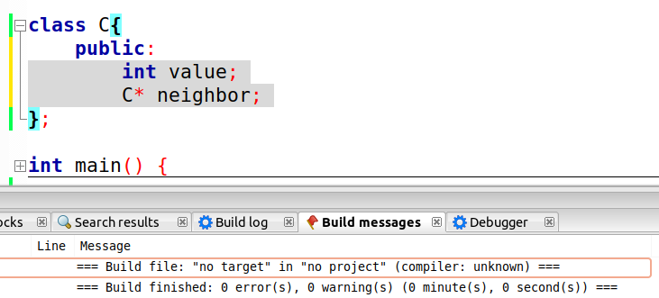
Can a class point to itself?
Looks like yes, but why?

Slide 4
What if we make a chain?
Value: 6
Neighbor:
Value: 1
Neighbor:
Value: 3
Neighbor:
NULL
Each link in the chain is holding one integer.
This chain could represent the list: [6, 1, 3]
This chain could continue to grow indefinitely.

Slide 5
Linked Lists
Chains for same-type classes are used to store a list with any number of values.
We do not have to know the size of the list at creation.
We have to keep track of the “head” of the list.
List nodes are created using dynamic memory allocation.

Slide 6
Example 1
class ListNode{
public:
int value;
ListNode* next;
};
int main(int argc, char** argv){
ListNode* head;
head = new ListNode;
  head→value = 7;
  head→next = NULL:
return 0;
} //try to guess the output
ListNode
val: 7
next: NULL

Slide 7
Linked List Tasks:
Create an empty list
Create a new node
Add a new node to front of list (given newNode)
Traverse the list (and output)
Find the last node (of a non-empty list)
Find the node containing a certain value
Find a node AND it’s previous neighbor.
Append to the end of a non-empty list
Delete the first node
Delete an element, given previous and next
Insert a new element, given previous and next

Slide 8
Task 1: Create an empty list
The NULL pointer value is used to indicate the end of a list.
Setting the head pointer to NULL shows that a list is empty.
Head
NULL
List = []

Slide 9
Task 2: Create a new node
The head pointer can be directed towards a dynamically allocated ListNode.
Head
NULL
Node
Val: 6
List = [6]
NULL

Slide 10
Task 3: Add a new node to front of list
The head pointer is re-directed to the new node.
The next pointer of the new node should be pointed to the old head.
The next pointer of the old head still points to NULL.
Node
Val: 6
Head
NULL
List = [3, 6]
Node
Val: 3

Slide 11
Example 2
class Node{
public:
int value;
Node* next;
Node(int v){
value = v;
next = NULL;
}
};
int main(int argc, char** argv){
Node* head = new Node(6);
Node* newNode = new Node(3);
newNode->next = head;
head = newNode;
return 0;
} //try to guess the output

Slide 12
Task 4: Traverse the list
A ListNode pointer can be used to examine each element in the list, starting at the head.
This could be done to print every value in a list.
The list pointer advances until it finds NULL.
Node
Val: 3
Node
Val: 6
Head
NULL
List = [3, 6]
Traversal
Pointer

Slide 13
Example 3
class Node{
public:
int value;
Node* next;
Node(int v){
value = v;
next = NULL;
}
};
void printList(Node* h){
while(h!=NULL){
cout << h->value << ' ';
h = h->next;
}
cout << endl;
}

Slide 14
Task 5: Find the last node of a non-empty list
Like traversal, but we should stop with the traversal pointer pointing to the node who’s next pointer is NULL.
Node
Val: 3
Node
Val: 6
Head
NULL
List = [3, 6]
Last Value = 6
Traversal
Pointer

Slide 15
Task 6: Find the node containing a value
Like traversal, but stop if a node’s value matches the target OR if the traversal pointer reaches NULL.
Node
Val: 3
Node
Val: 6
Head
NULL
List = [3, 6]
Target Value = 4
Traversal
Pointer

Slide 16
Task 7: Find a node AND it’s previous neighbor.
Traverse with two pointers, one leading and one following.
Halt on target value OR if the leading pointer is NULL.
Node
Val: 3
Node
Val: 6
Head
NULL
List = [3, 6]
Target Value = 4
NULL
Following
Pointer
Leading
Pointer

Slide 17
Task 8: Append to the end of a non-empty list
First, find the end of the list (task 5).
Set the next pointer of the old tail to point to the new node.
Set the next pointer of the new tail to NULL.
Node
Val: 3
Node
Val: 6
Head
NULL
List = [3, 6, 4]
Node
Val: 4
NULL

Slide 18
Example 4
class Node{
public:
int value;
Node* next;
Node(int v){
value = v;
next = NULL;
}
};
int main(int argc, char** argv){
Node* head = new Node(6);
Node* newNode = new Node(3);
newNode->next = head;
head = newNode;
Node* tail = head;
while(tail->next != NULL)
tail = tail->next;
tail->next = new Node(4);
return 0;
} //try to guess the output

Slide 19
Task 9: Delete the first node
Linked lists are dynamically allocated memory, so it’s our job to clean up.
Assign a pointer to the head node, reassign the head pointer to head→next, the the old head.
Node
Val: 3
Node
Val: 6
Node
Val: 4
Head
NULL
ToDelete
List = [6, 4]

Slide 20
Example 5
class Node{
public:
int value;
Node* next;
Node(int v){
value = v;
next = NULL;
}
};
int main(int argc, char** argv){
Node* head = new Node(3);
head->next = new Node(6);
head->next->next = new Node(4);
Node* oldHead = head;
head = head->next;
delete oldHead;
return 0;
} //try to guess the output

Slide 21
Task 10: Delete an element, given previous and next
Delete previous→next.
Assign previous→next to next.
Node
Val: 3
Node
Val: 6
Node
Val: 4
Head
NULL
Previous
List = [3, 4]
Next

Slide 22
Example 6
class Node{
public:
int value;
Node* next;
Node(int v){
value = v;
next = NULL;
}
};
void deleteNode(int target, Node* next){
Node* prev = NULL;
while(next!=NULL){
if(next->value == target)
break;
prev = next;
next = next->next;
}
prev->next = next->next;
delete next;
}

Slide 23
Task 11: Insert a new element, given previous and next
Set previous→next to point to the new node.
Assign the new nodes next pointer to point to next.
Node
Val: 1
Node
Val: 3
Node
Val: 6
Node
Val: 4
Head
NULL
List = [3, 6, 1, 4]
Previous
Next

Slide 24
Example 7
class Node{
public:
int value;
Node* next;
Node(int v){
value = v;
next = NULL;
}
};
void insetBetween(int newVal, Node* p, Node* n)
{
p->next = newNode(newVal);
p->next->next = n;
}

Slide 25
Linked Lists in Memory
Consecutive elements of a list do not have to be stored in consecutive addresses.
List nodes can be added until a program runs out of memory.

Slide 26
Questions or Comments?

